Slide 1
LECTURE 7

Slide 2

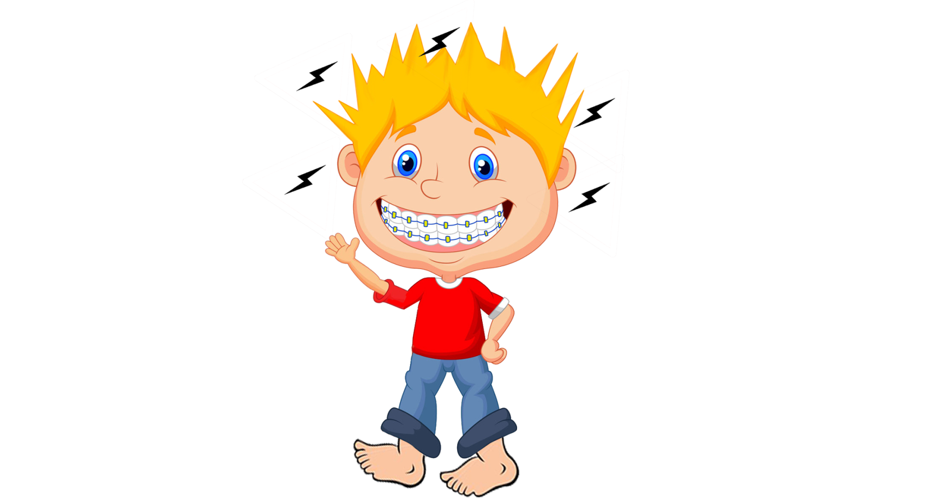
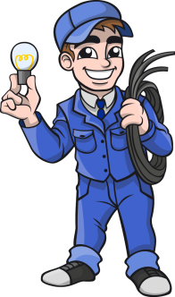


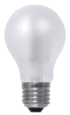
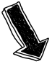
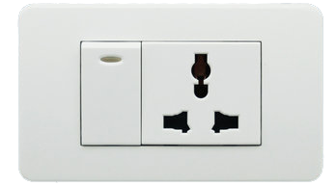
Wire carrying electricity should not be
touched bare footed
Domestic power supply is 220 V
So current will flow from higher potential to lower potential and the person will get a shock
220 V
+
–
This is similar to
Human body is a good conductor of electricity
If circuit is broken,
current will not flow
0 V
Earth is at zero potential

Slide 3

Wire carrying electricity should not be
touched bare footed
Current will not flow through his body and will not get electric shock
A person wearing rubber soled shoes
As rubber is a insulator

Slide 4

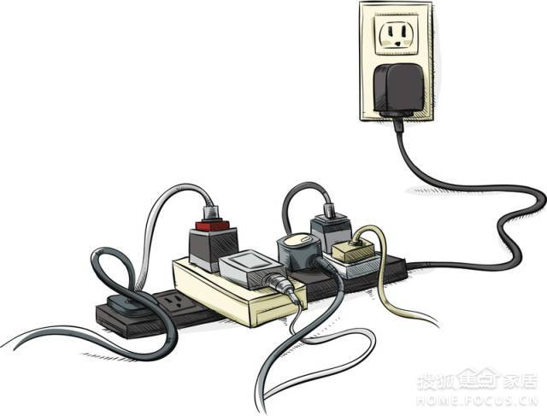

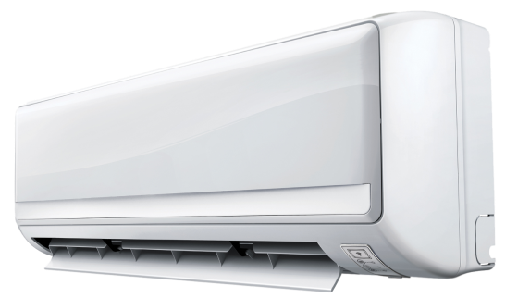
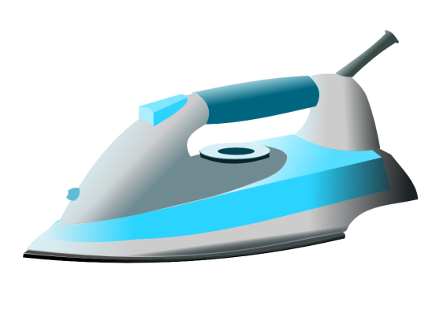
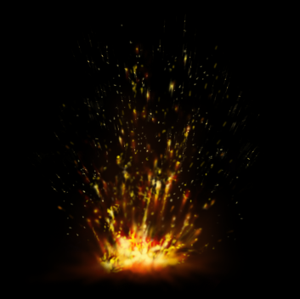

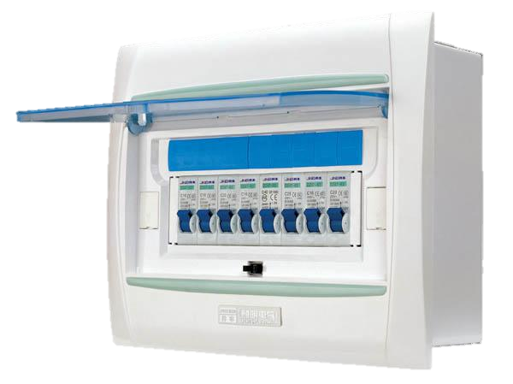
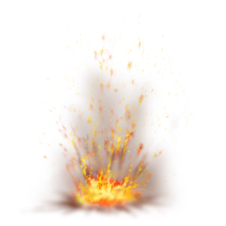
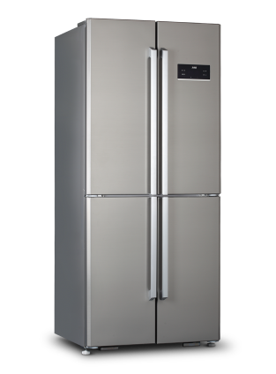

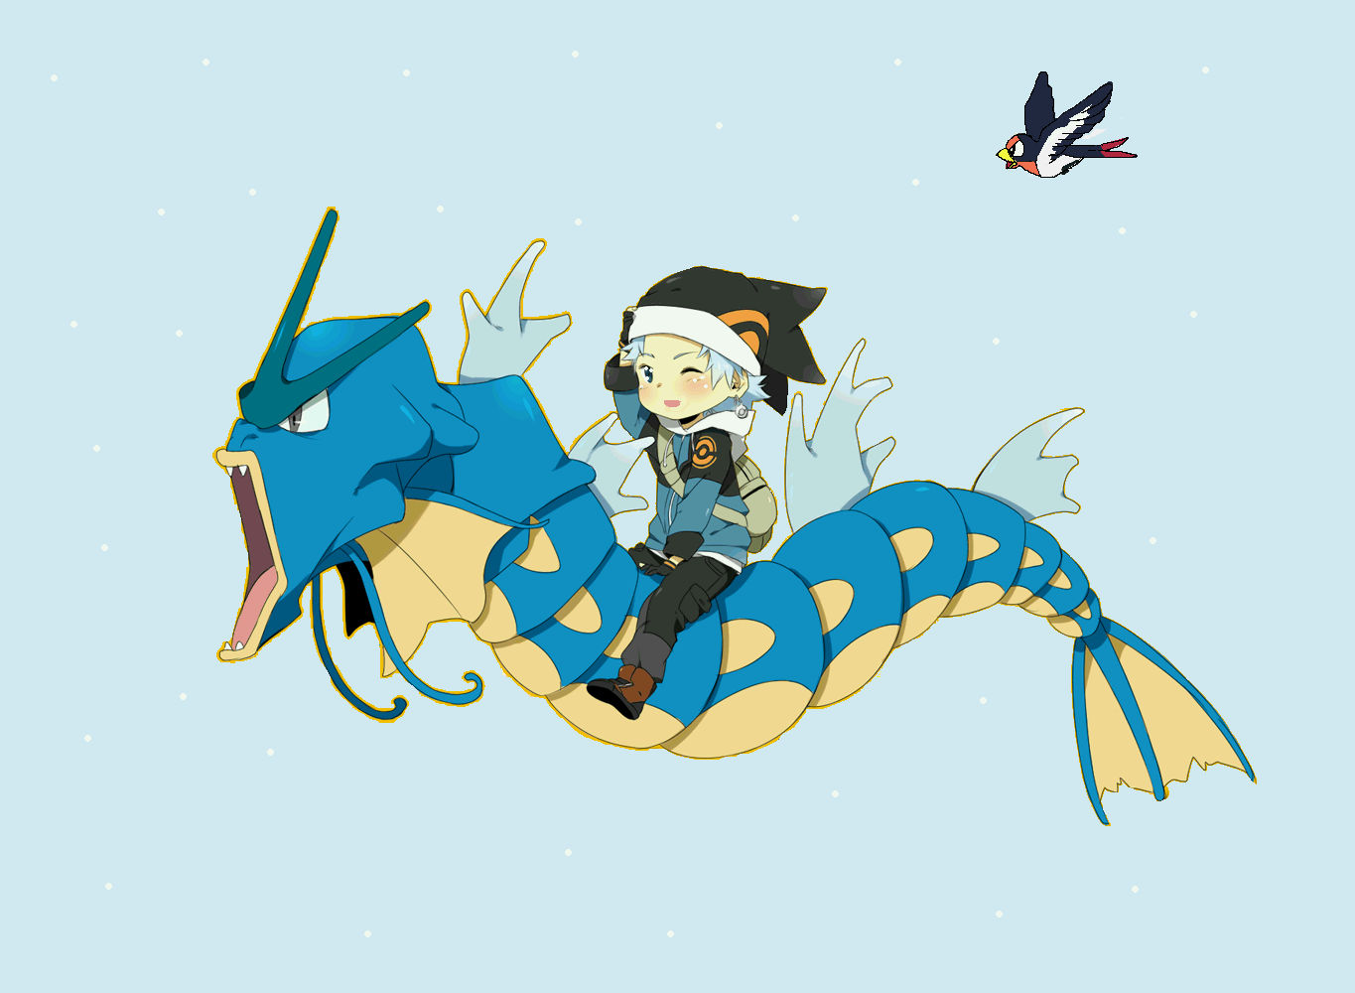
MAIN SUPPLY
Overloading
FUSE

Slide 5

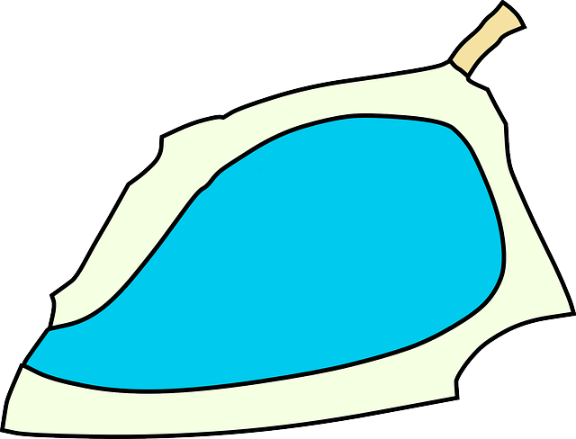
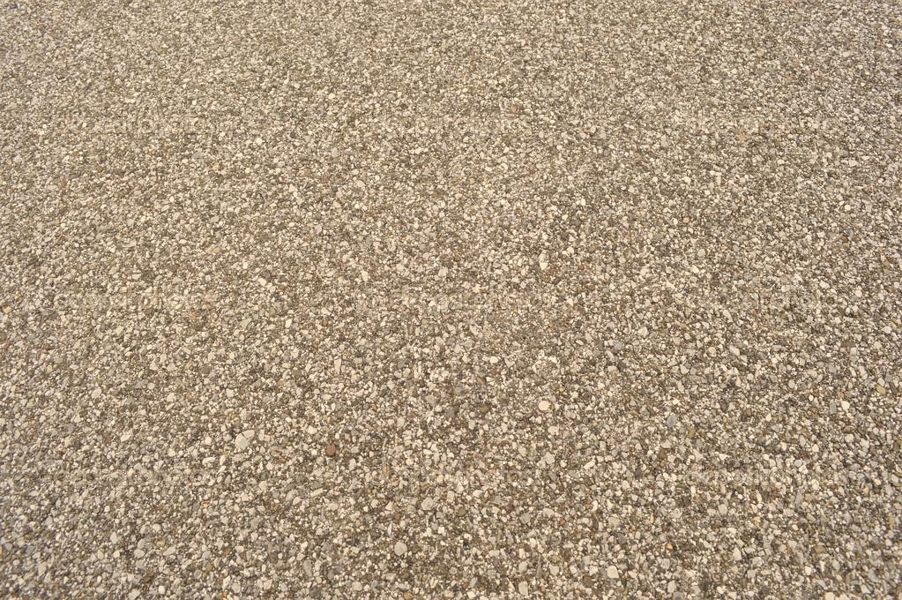


Earth Wire
Live Wire
Neutral Wire
Consider an appliance
e.g. - an
electric iron
Due to faulty material if current leaks through the coil, the current will flow through the metallic body of iron
Hence, shock is prevented
In addition to this, an extra wire is connected to the metallic part of iron
Electric iron has a high resistance coil connected to live & neutral wire
And the person handling the device may get a severe electric shock
But here the additional wire connected to metallic part plays its role
Live and neutral wires
Earthing Pit , in which a copper plate is fitted
EARTHING
Now this extra current is taken by the earth wire to the copper plate which is in the ground
Copper plate

Slide 6
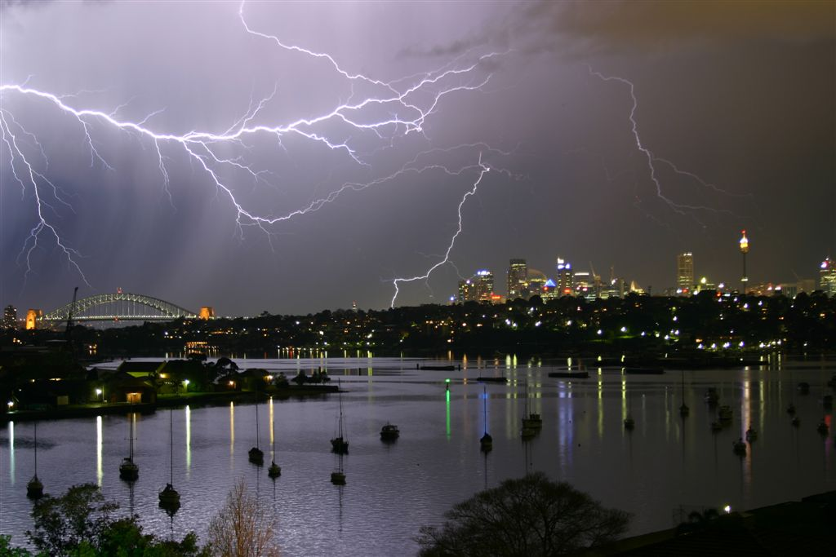
In rainy season, roof and walls of a building are wet so they become good conductor of electricity.
Electric circuits should be switched off during lighting. This will save the electrical appliances from burning.

Slide 7
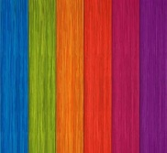

Q.
What precaution should be taken to avoid the overloading of domestic electric circuits?
Ans.
As a result of overloading, the connecting wires get over-heated and the appliances may get damaged. To avoid this, the following safety measures must be taken:
The wires used in the circuit must be coated with good insulating materials like PVC, etc.
The circuit must be divided into different sections and a safety fuse must be used in each section.
High power appliances like air-conditioner, refrigerator, water heater, etc., should not be used simultaneously.

Slide 8
Q.
Name two safety measures commonly used in electric circuits and appliances.
Ans.
Earthing
Electric fuse

Slide 9
At the time of short circuit, the current in the circuit
reduces substantially.
does not change
increases heavily.
vary continuously.
Q.
Ans.
C) increases heavily.

Slide 10
An electric oven of 2 kW power rating is operated in a domestic electric circuit (220 V) that has a current rating of 5 A. What result do you expect? Explain.
Q.
Ans.
The electric oven draws a current given by
P
2 kW
2000 W
I =
=
=
= 9.09 A
V
220V
220V
Thus the electric oven draws current much more than the current rating of 5 A. That is the circuit is overloaded. Due to excessive current, the fuse wire blows and the circuit is broken.

Slide 11
Which of the following correctly describes the magnetic field near a long straight wire?
(a) The field consists of straight lines perpendicular to the wire.
(b) The field consists of straight lines parallel to the wire.
(c) The field consists of radial lines originating from the wire.
(d) The field consists of concentric circles centered on the wire.
Q.
Ans.
(d). The field consists of concentric circles centered on the wire.

Slide 12
The phenomenon of electromagnetic induction is
the process of charging a body.
the process of generating magnetic field due to a current passing through a coil
producing induced current in a coil due to relative motion between a magnet and the coil.
the process of rotating a coil of an electric motor.
Q.
Ans.
(c). Producing induced current in a coil due to relative motion between a magnet and the coil.

Slide 13
The device used for producing electric current is called a
generator
galvanometer
ammeter
motor
Q.
Ans.
generator

Slide 14
The essential difference between an AC generator and DC generator is that
AC generator has an electromagnet while a DC generator has a permanent magnet.
DC generator will generate a higher voltage.
AC generator will generate a higher voltage.
AC generator has slip rings while the DC generator has a commutate.
Q.
Ans.
(d). AC generator has slip rings while the DC generator has a commutate.

Slide 15
Q.
When is the force experienced by a current-carrying conductor placed in a magnetic field largest?
Ans.
When the conductor carries current in a direction perpendicular to the direction of the magnetic field, the force experienced by the conductor is largest.

Slide 16
A coil of insulated copper wire is connected to a galvanometer. What will happen if a bar magnet is (i) pushed into the coil, (ii) withdrawn from inside the coil, (iii) held stationary inside the coil?
Q.
Ans.
An electric current is induced in the coil and the galvanometer shows a deflection.
An electric current is induced in the coil but in opposite direction. The galvanometer shows a deflection in reverse direction.
No current is induced in the coil. The galvanometer shows no deflection.

Slide 17

Q.
Mahesh bought an electric iron and connected its wires into the two pin plug. Obviously the green wire was not connected anywhere. Few days later his wife got a serve electric shock while ironing the clothes. The electrician told Mahesh that this situation could be averted, if he had connected the green wire also, using the three pin plug. Mahesh learnt a lesson for a life time.
Read the above passage and answer the following question:
(i) Which terminal was to be connected using green wire?
(ii) What qualities does Mahesh need to incorporate in himself to avoid such mistakes?
(iii) If you were the electrician, what else would you do than explaining to Mahesh?
Ans.

Slide 18
Q.
One day Neil connected many household high power appliances having a current ratting more than 6 A to a multiple of 6A rating. When he was about to switch them on, his older sister shouted and asked him to remove the appliances from a single socket.
Read the above passage and answer the following question:
(i) According to you, why she would not advice to connect multi-high power appliances on a single socket?
(ii) What would have happened, if he switched them on?
(iii) What would have happened, if be switched them on?
(iii) What was the value shown by Neil’s sister?
Ans.

Slide 19
Q.
Diagram shows the lengthwise section of a current carrying solenoid.
Indicates current entering into the page,
Indicates current emerging out of the page.
A
B
Decide which end of the solenoid A or B, will behave as North pole. Give reason for your answer. Also, draw field lines inside the solenoid.
Ans.

Slide 20
Q.
For the current carrying solenoid as shown below, draw magnetic field lines and give reason to explain that out of the three points A, B and C at which point the field strength is maximum and at which point it is minimum.
B
Ans.
C
A

Slide 21
Q.
A circular metallic loop is kept above the wire AB as shown below:
What is the direction of induced current produced in the loop, if any when the current flowing in the straight wire
(i) Is steady, i.e. does not vary?
Is increasing in magnitude?
Justify your answer in each case.
A
B
Ans.

Slide 22
Q.
A copper coil is connected to a galvanometer. What would happen, if a bar magnet is
(i) Pushed into the coil with its North pole entering first?
Held at rest inside the coil?
(ii) Pulled out again?
Ans.

Slide 23
Q.
A plotting compass is placed inside a solenoid and the compass needle is pointing in the direction as shown.
(i) Complete the diagram by drawing arrow heads to indicate the direction of the current flow.
Describe the direction of the magnetic field inside the solenoid.
Ans.

Slide 24
Q.
The wire in the figure below is being moved downwards through the magnetic field, so as to produce induced current.
What would be the effect of
(i) Moving the wire at a higher speed?
Moving the wire upwards rather than downwards?
(iii) Using a stronger magnet?
(iv) Holding the wire still in the magnetic field?
Ans.

Slide 25
Thank You

